Slide 1
“COVID” Forecasting Cases & Deaths
Guided BY: | Team Member:
Jongwook Woo | Jay Joshi Shradha Shinde Sowmya Mareedu

Slide 2
Introduction
Corona is a deadly disease that started spreading throughout the world starting in December 2019. It was first diagnosed in Wuhan, China.
Since then, it has spread worldwide and has effected 2,475,440 people and 170,069 people have died due to this infection.
Scientists have since then dedicated their time in the research of this disease and here we attempt to take a deeper look into this problem.
JJ

Slide 3
Dataset
As this is Dataset URL :-
https://github.com/datasets/covid-19
https://www.accuweather.com
File Size : 81.7 Megabytes
Number of rows : 540
Number of Columns : 13
Number of File : 8
File Format : csv (Comma-separated Values)
SM

Slide 4


Technical Specifications
Free Workspace
10 GB storage
Single node
R
Data Bricks Subscription
Cluster 5.2 (includes Apache Spark 2.4.0, Scala 2.11)
6 GB Memory, 0.88 Cores, 1 DBU
Python Version 3.2

Slide 5
Technical Specifications
Cluster 5.2 (Includes Apache Spark 2.4)
2.20 GHz memory
802 GB Storage Memory
Python Version 3

Slide 6
In Azure ML, we have implemented ARIMA (Auto Regressive Integrated Moving Average) Seasonal & Non seasonal, ETS using R Extraction service ETS
For prediction of cases and deaths by weather factor we have implemented Linear Regression and Depth Forest Regression is implemented using pyspark in Databricks
For prediction of cases and deaths by time series prediction using Python Facebook Prophet in Databricks for prediction in Los Angeles and New York city.
We have used Oracle CLI for deaths and cases by weather factor for four cities
New York
Los Angeles
Washington
Philadelphia
SM

Slide 7
Flowchart
Gathering Data
Data Preprocessing
Train and Test
Evaluate
Data Split
SM

Slide 8


Slide 9
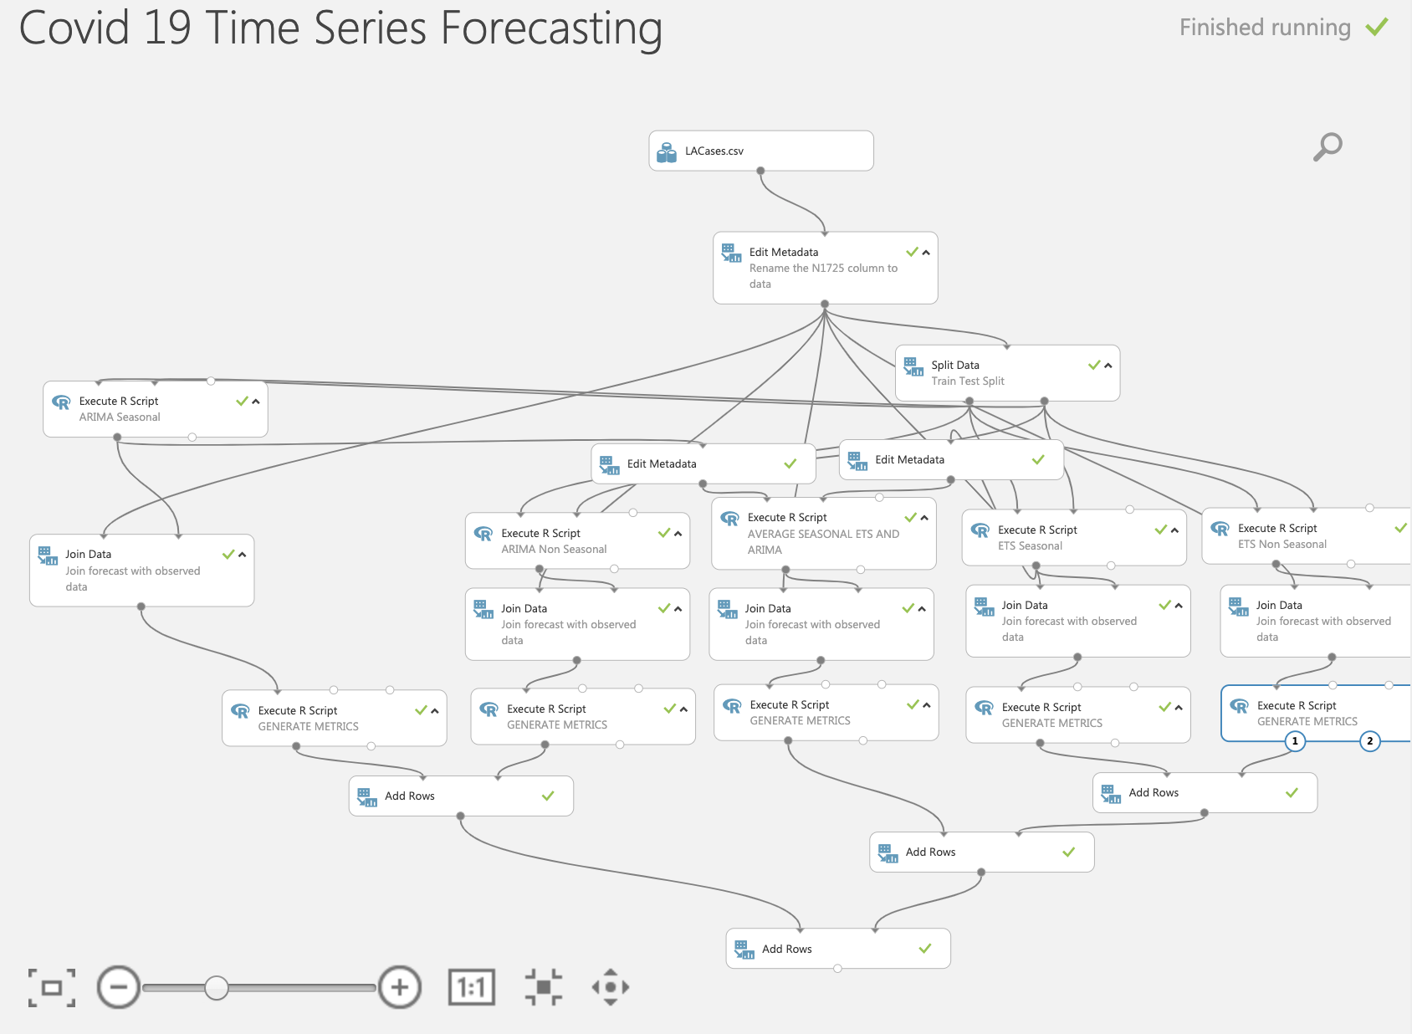

Slide 10
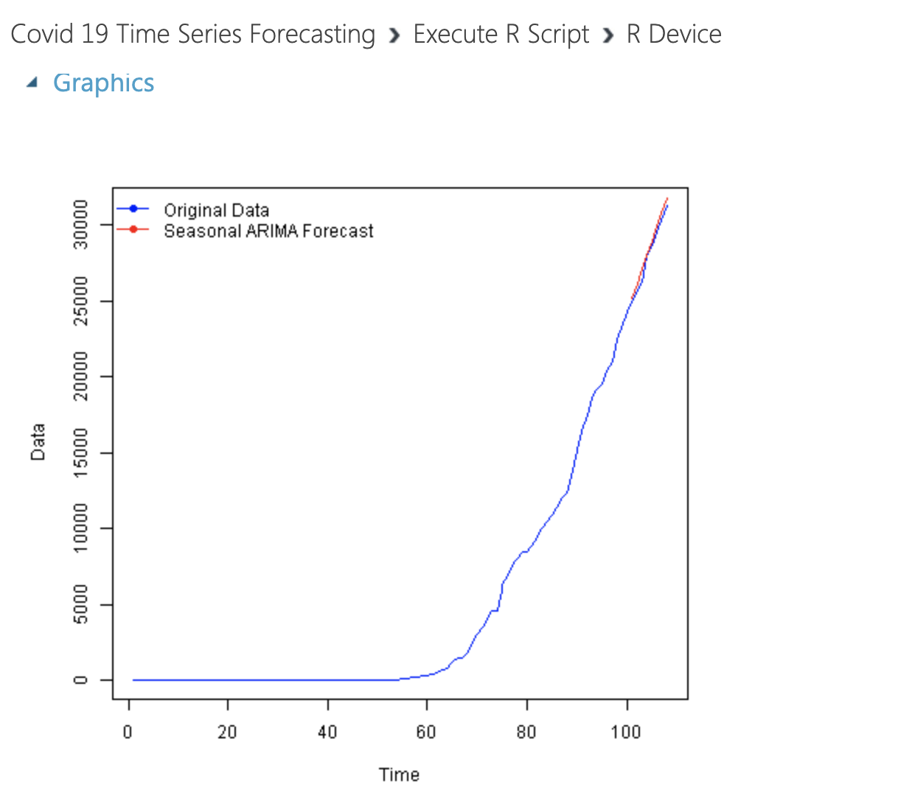
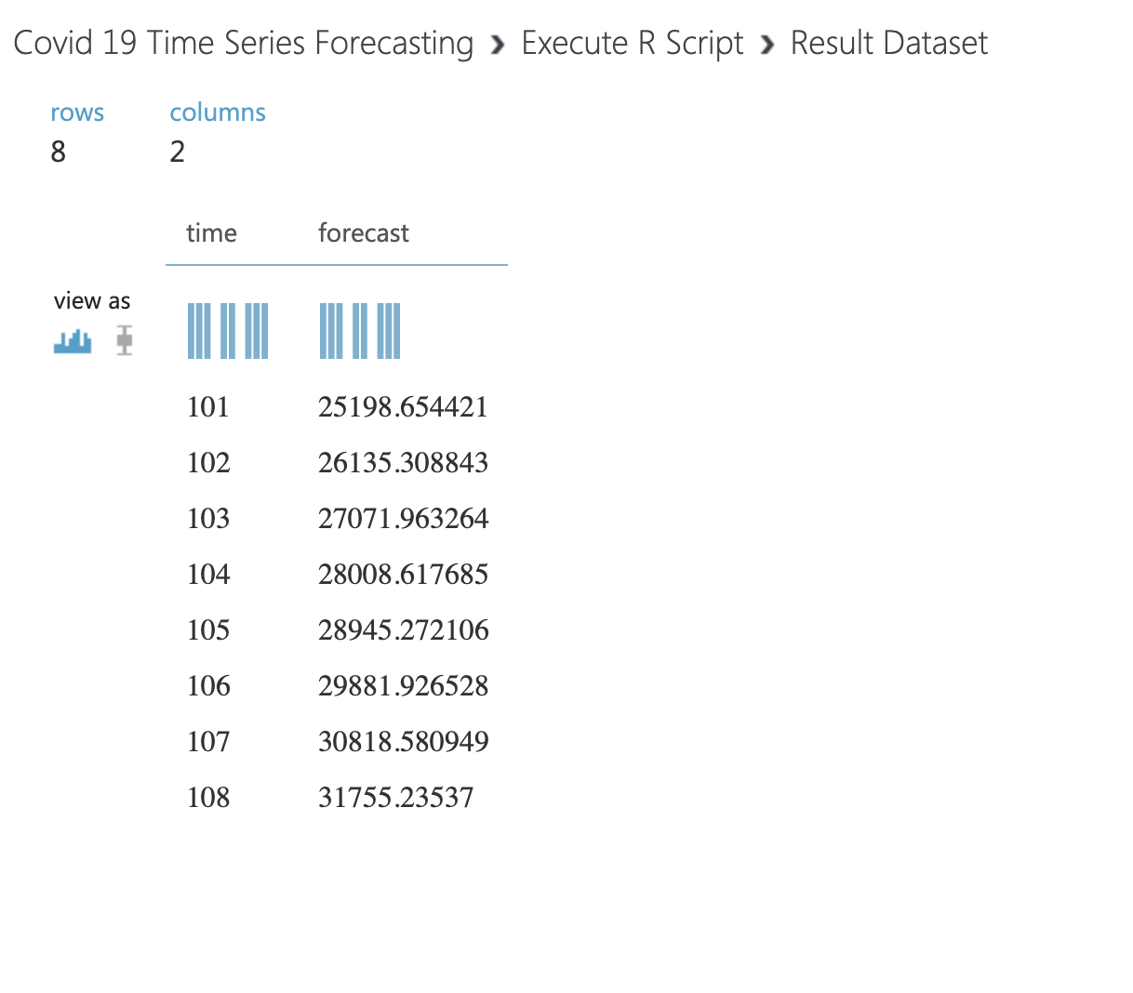
Results- Forecasting Graphs

Slide 11
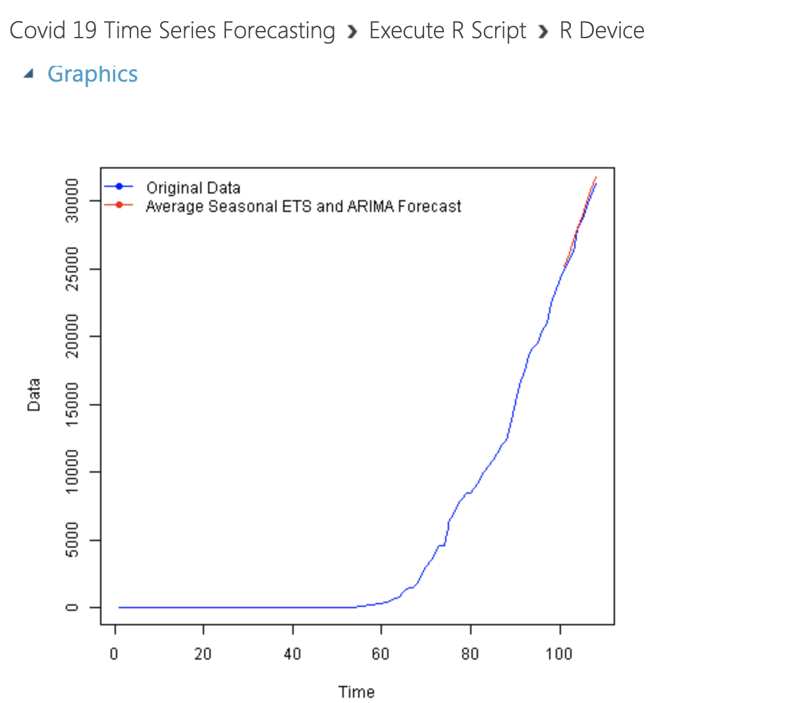
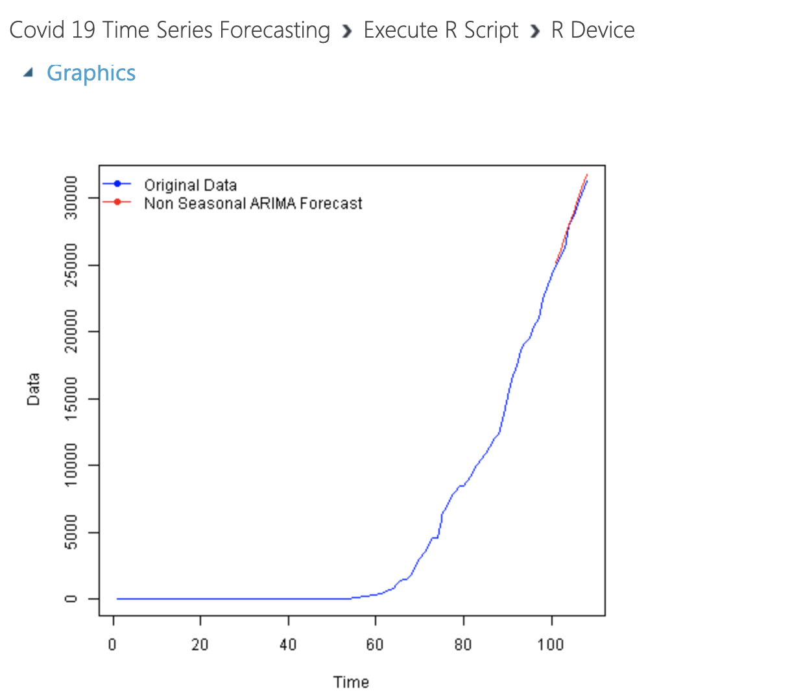
Results- Forecasting Graphs

Slide 12
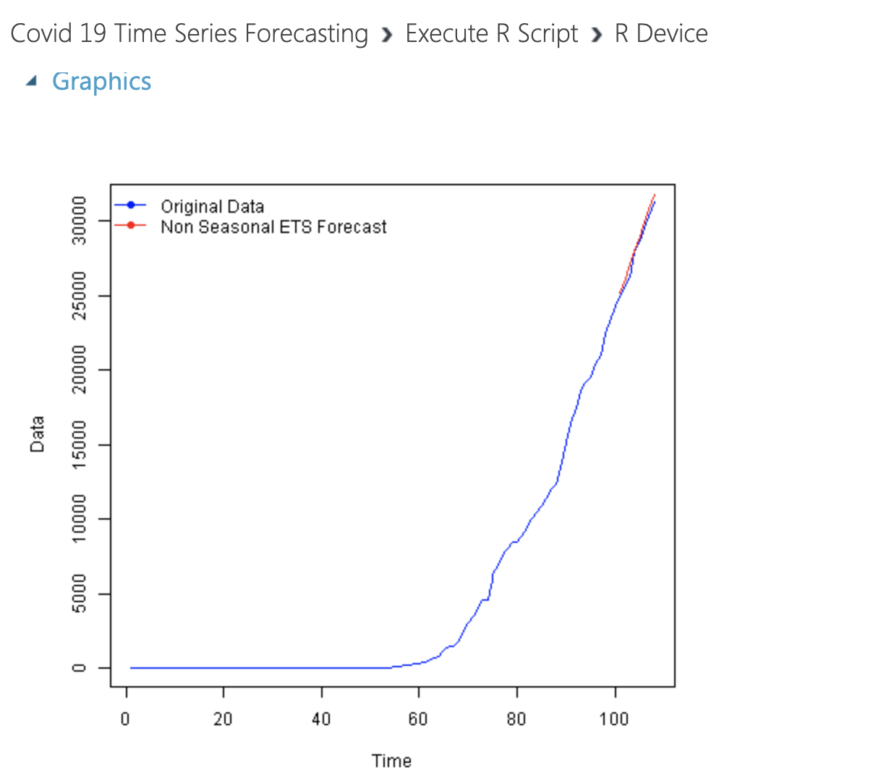
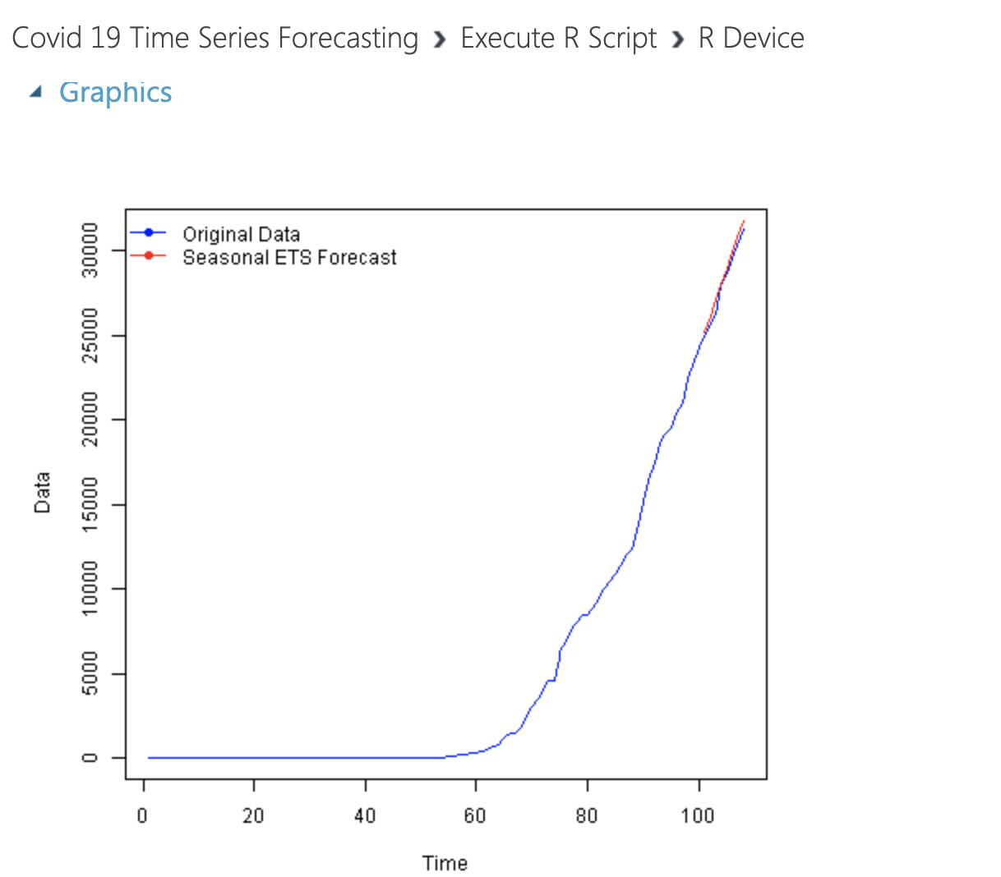
Results- Forecasting Graphs

Slide 13
Results- Forecasting Graphs

Slide 14
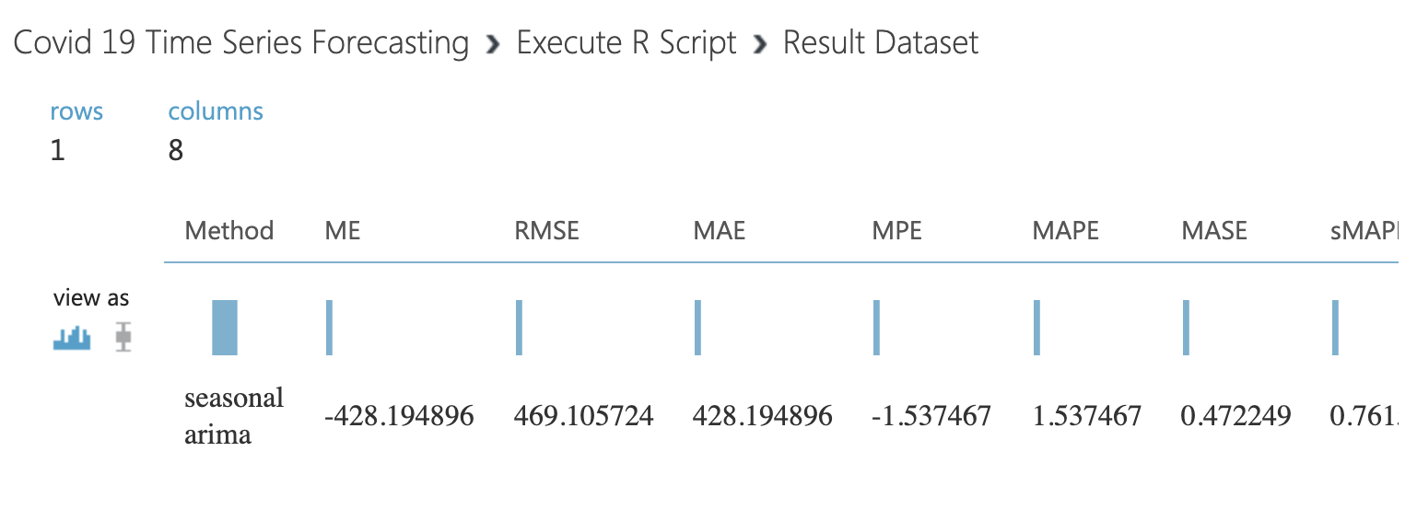
Results - RMSE
Method: Seasonal ARIMA

Slide 15
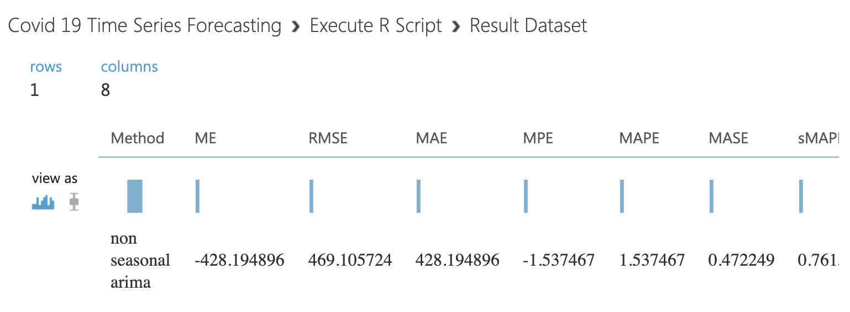
Results - RMSE
Method: Non- Seasonal ARIMA

Slide 16
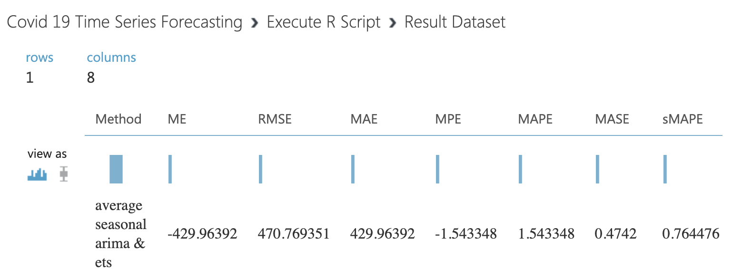
Results - RMSE
Method: Average Seasonal ARIMA & ETS

Slide 17
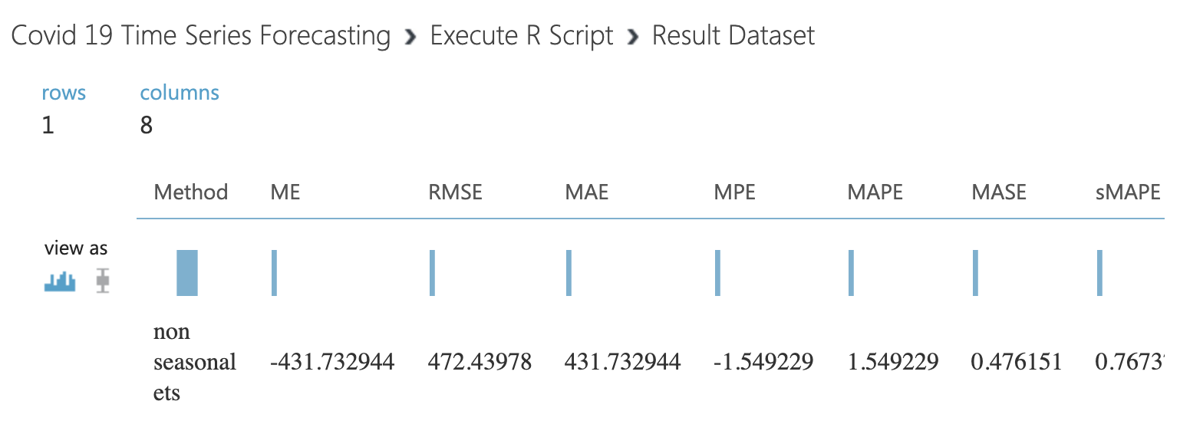
Results - RMSE
Method: Non- Seasonal ETS

Slide 18
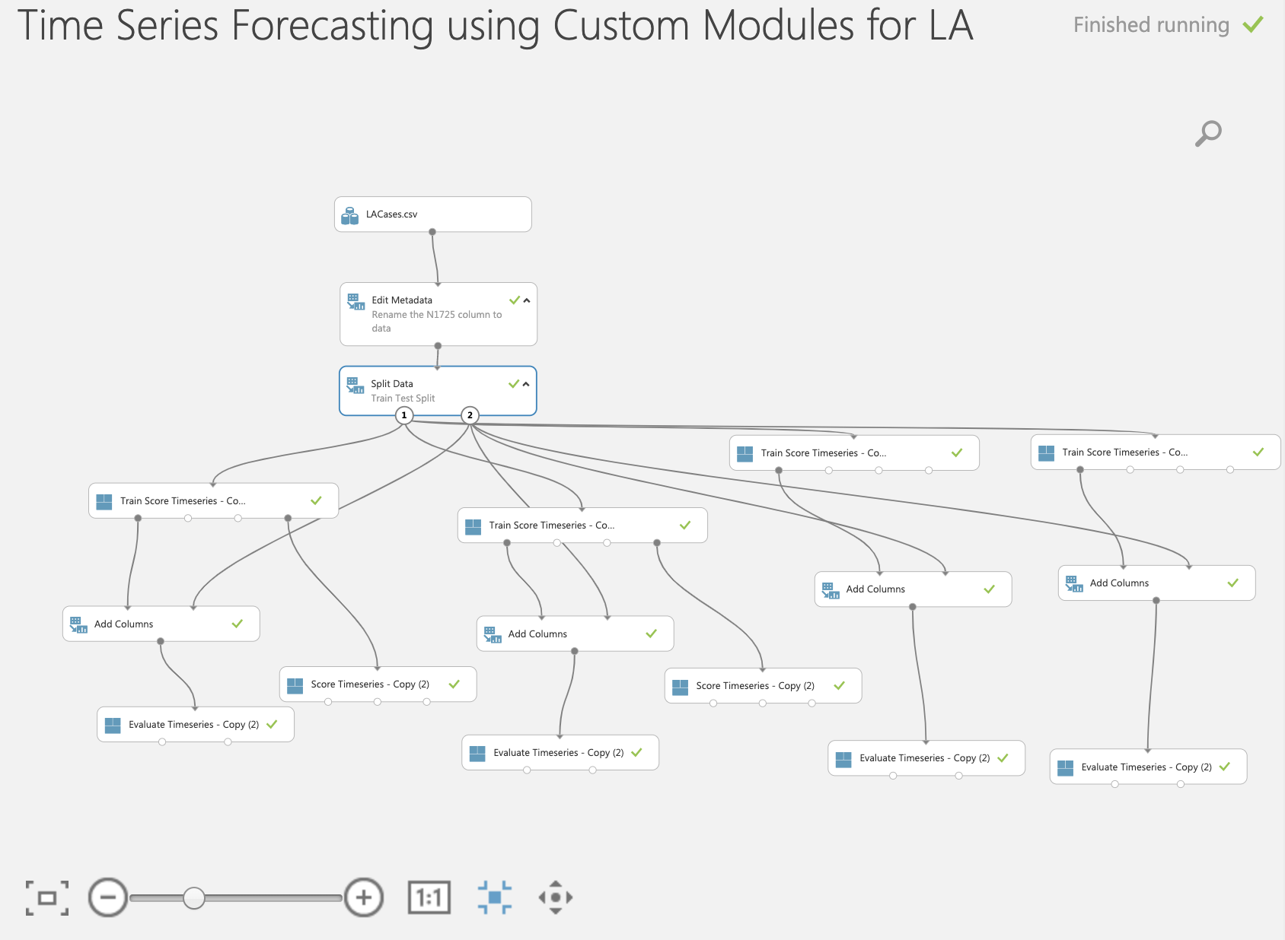
Time Series Forecasting

Slide 19
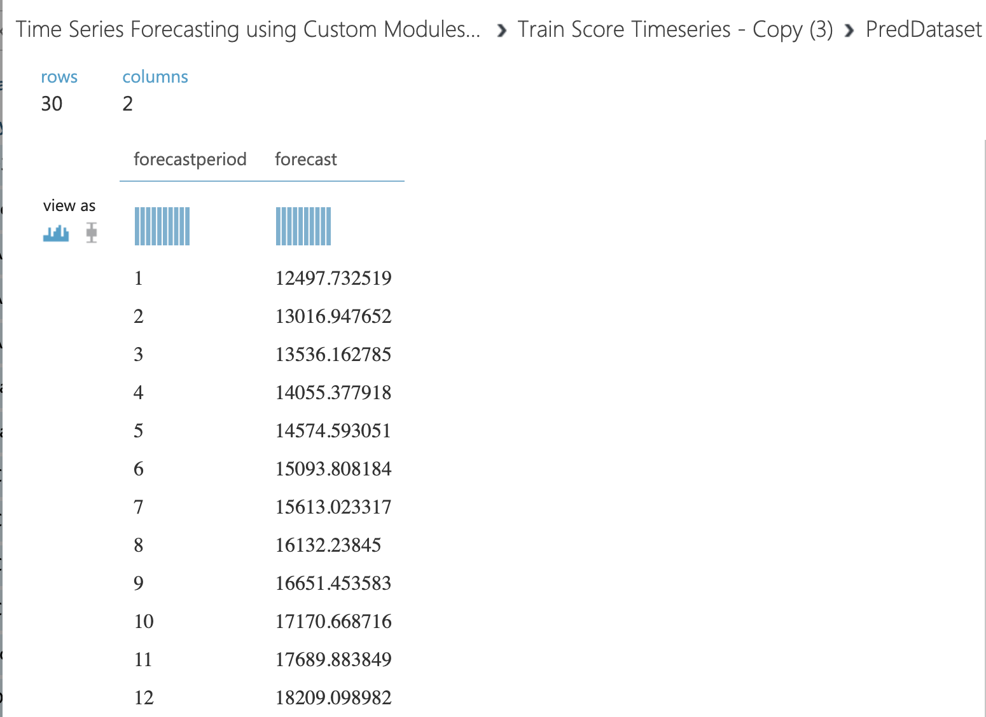

Results – Custom Module

Slide 20
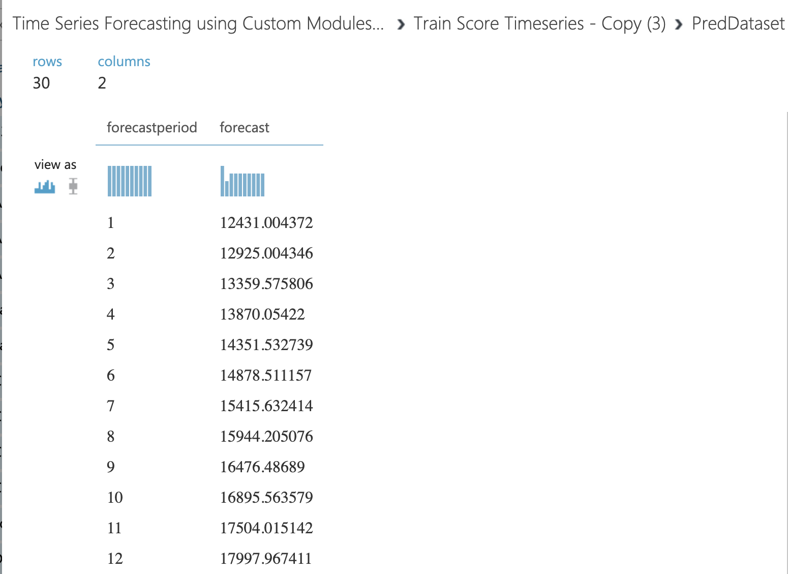
Results – Custom Module

Slide 21

JJ

Slide 22
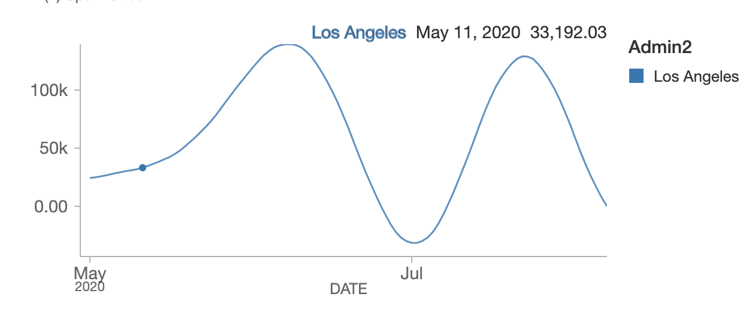
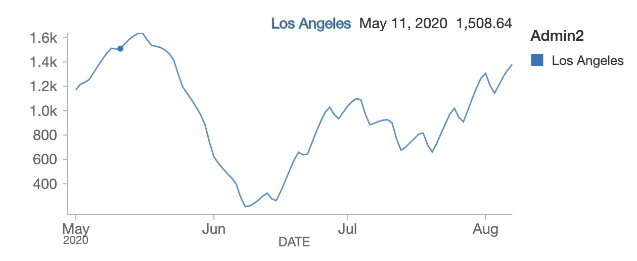
Time Series Prediction- Los Angeles
Cases
Deaths
JJ

Slide 23
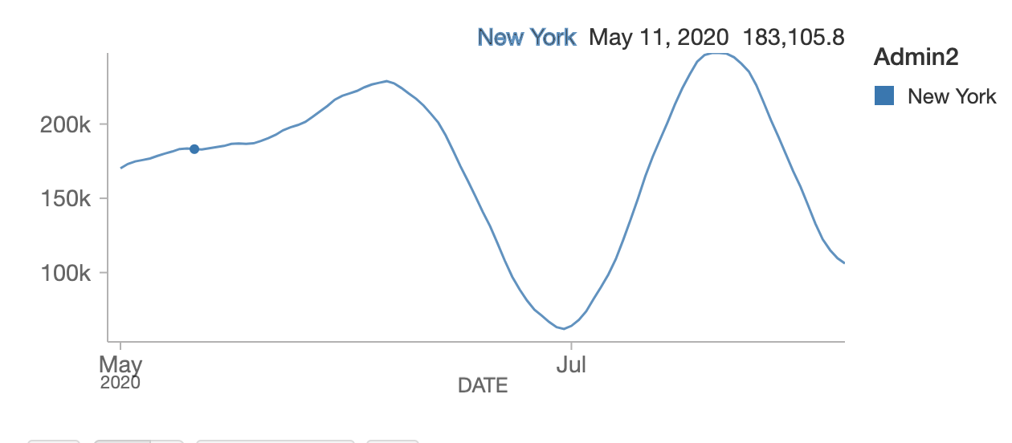
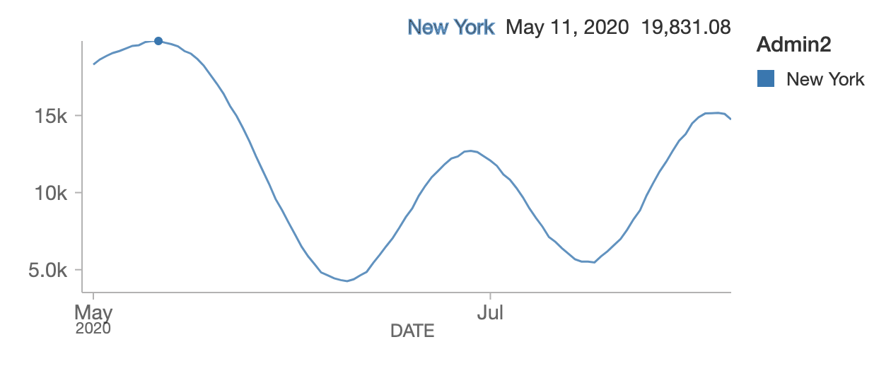
Time Series Prediction- New York
Cases
Deaths
JJ

Slide 24
Results- AUC -Weather Factor
Cases
LR Algorithm: 0.916030534351145
DR Algorithm: 0.9416058394160584
Deaths
LR Algorithm: 0.9260305343511
DR Algorithm: 0.9316058394160584
SM

Slide 25

Oracle CLI
SM

Slide 26
Results- AUC
Cases
LR Algorithm: 0.9596774193548387
DR Algorithm: 0.965753424658
Deaths
LR Algorithm: : 0.9496774193548387
DR Algorithm: 0.975753424658
SM

Slide 27
Conclusion (Summary Table)
Azure ML | RMSE
Arima Seasonal | 469.105724
Arima Non-Seasonal | 469.105724
Average Seasonal ETS and Arima | 470.769351
ETS Seasonal | 471.43979
ETS Non-Seasonal | 472.43978
Spark | AUC
Logistic Regression Model | 0.916030534351145
Decision Tree Regression Model | 0.9416058394160584
Oracle BDCE | AUC
Logistic Regression Model | 0.9596774193548387
Decision Tree Regression Model | 0.965753424658
SM

Slide 28
Conclusion
Weather Factor is not prominent in prediction of deaths & casesdue to COVID.
In Azure ML, ARIMA seasonal and non seasonal forecast is better compared to other algorithms.
In comparison with WORLDOMETER, we have decent similar results for predicting number of cases and deaths.
SM

Slide 29

Thank you!
Taken from https://en.wikipedia.org/wiki/Mickey_Mouse

